Slide 1
Chapter 11: Project Risk Management
Information Technology Project Management, 8th Edition

Slide 2
Learning Objectives
Understand risk and the importance of good project risk management
Discuss the elements of planning risk management and the contents of a risk management plan
List common sources of risks on information technology (IT) projects
Describe the process of identifying risks and create a risk register
Discuss qualitative risk analysis
Explain quantitative risk analysis
Provide examples of using different risk response planning strategies to address both negative and positive risks
Discuss how to control risks
Notes:
Goals & Objectives:
Project Risk – What is it, and how do you known when you have found it
Risk Mgmt – PMBOK Definition, and steps to the entire management process
Risk Mgmt Planning – Discuss “planning for the plan”, appropriateness (6 questions to ask yourself before planning.)
Identify – What is a risk and how do you identify it
Qualify – Create a prioritized list based on gut/history
Quantify – Top risks should be quantified for probability and impact (examples)
Response Planning – What are we going to do if? Who is going to be responsible? The Risk Register!
Risk Monitoring & Control – Keeping and eye open and following your plan.
Tools… - Give you some ideas of where to go, how to do this, and what some examples look like.

Slide 3

What is Project Risk?
It is a fact of life that chance events will occur and affect the outcome of your project
Murphy’s Laws codify this “knowledge”
If anything can go wrong, it will!
Of things that could go wrong, the one that causes the most damage will occur!
Project risks are defined as the undesirable event, the chance this event might occur and the consequences of all possible outcomes
Simply put “An event that, if it occurs, causes either a positive or negative impact on a project”
Keys attributes of Risk
Uncertainty
Positive and Negative
Cause and Consequence
1982 Darwin Award Honorable Mention given to “Lawn Chair” Larry Walters. Cartoon by Jay Ziebarth, 2002
Notes:
CAN NOT be done until a WBS has been developed…you must know WHAT the project is and is not.
It is not just the BIG stuff…the little things can hurt the most
KEYS:
Uncertainty – It could happen, and well it might not, too.
Focus for this presentation is on Negative, but there are positive risks (AKA – opportunities)
All risks have a cause and a consequence. Your job through this process is to identify these.
Known – identified and addressed…Unknown – those risks you cannot identify or know about and cannot be managed (budget for them only)
Risk overall guide project success…a company/agency may be more or less risk averse which will determine how they view risks and the responses required for them. Some risk can be good if the reward is offsetting the risk.

Slide 4
Why manage risks?
Risk management attempts to identify such events, minimize their impact & provide a response if the event is detected
The essence of Project Management is Risk Management!
A risk is a probability that some adverse (or positive) circumstance will occur
Project risks affect schedule or resources;
Product risks affect the quality or performance of the software being developed;
Business risks affect the organization developing or procuring the software.
Notes:
Murphy’s Laws is an adage or epigram
“If anything can go wrong, it will!”
“Of things that could go wrong, the one that causes the most damage will occur!”

Slide 5
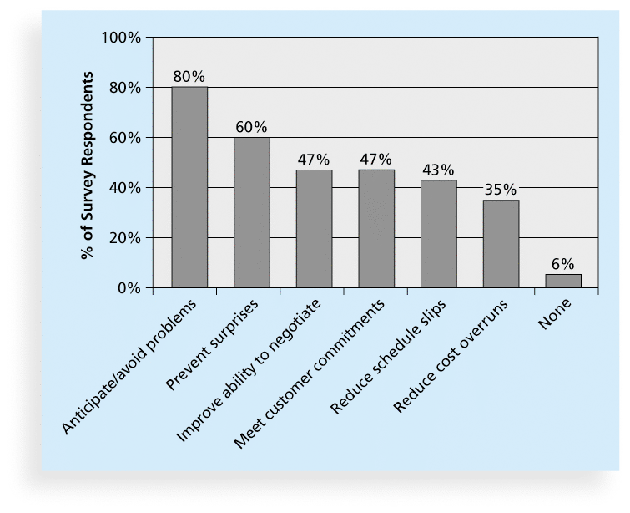
The Importance of Project Risk Management
Project risk management is the art and science of identifying, analyzing, and responding to risk throughout the life of a project and in the best interests of meeting project objectives
Risk management is often overlooked in projects, but it can help improve project success by helping select good projects, determining project scope, and developing realistic estimates
Figure 11-1. Benefits from Software Risk Management Practices*
Notes:
Risk management is concerned with identifying risks and drawing up plans to minimise their effect on a project.
A risk is a probability that some adverse (or positive) circumstance will occur
Project risks affect schedule or resources;
Product risks affect the quality or performance of the software being developed;
Business risks affect the organization developing or procuring the software.
With so much benefit to managing risk, why is it often overlooked? :
The organization is too busy with real problems to worry about potential ones,
There is a perception that there is not too much that can go wrong, or
They have a fatalistic belief that not much can be done about risks, or
“Shoot the messenger mentality”; fear that disclosure of project risks will be seen as an indication of project weakness.
Value From Managing Risks
Opportunity to move from “fire-fighting” to proactive decision making on the project.
Better chance of project success.
Improved project schedule and cost performance.
Stakeholders and team members better understand the nature of the project.
Helps define the strengths and weaknesses of the project.

Slide 6
Positive and Negative Risk
Positive Risk
Negative Risk
Positive risks are risks that result in good things happening; sometimes called opportunities
A general definition of project risk is an uncertainty that can have a negative or positive effect on meeting project objectives
The goal of project risk management is to minimize potential negative risks while maximizing potential positive risks
Negative risk involves understanding potential problems that might occur in the project and how they might impede project success
Negative risk management is like a form of insurance; it is an investment
Notes:
All projects have risks, denial does not make them go away, it just makes you unprepared for them if they occur.
Risk - an uncertain event or condition that if it occurs can present a positive or a negative effect one or more project objectives.
Risk in itself is not bad, it is how well the project plans for and reacts to risks that counts.
Formal risk management is a cornerstone of good project management. Stakeholder visibility into project risks makes it easier to get additional resources and organizational support when risks do occur.
Positive risk = opportunity
Negative risk = threat

Slide 7
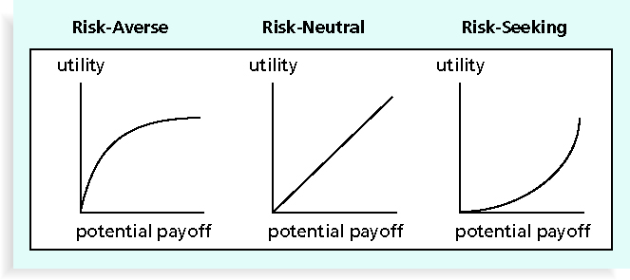
Risk Utility
Risk utility or risk tolerance is the amount of satisfaction or pleasure received from a potential payoff
Utility rises at a decreasing rate for people who are risk-averse
Those who are risk-seeking have a higher tolerance for risk and their satisfaction increases when more payoff is at stake
The risk-neutral approach achieves a balance between risk and payoff
Notes:
Risk Utility = risk vs payoff
Risk Aversion - low risk

Slide 8
Project Risk Management Processes
Planning risk management : Deciding how to approach and plan the risk management activities for the project
Identifying risks: Determining which risks are likely to affect a project and documenting the characteristics of each
Performing qualitative risk analysis: Prioritizing risks based on their probability and impact of occurrence
Performing quantitative risk analysis: Numerically estimating the effects of risks on project objectives
Planning risk responses: Taking steps to enhance opportunities and reduce threats to meeting project objectives
Monitoring and Controlling risk: Monitoring identified and residual risks, identifying new risks, carrying out risk response plans, and evaluating the effectiveness of risk strategies throughout the life of the project
Notes:
Risk management is a process
PMBOK ® Definition
“The systematic process of identifying, analyzing, and responding to project risk”
It is iterative, continuous and can be done in many different ways
This is PMI’s approach that can be tailored to your specific agency/business
Identify….Analyze….Respond
Risk identification
Identify project, product and business risks;
Risk analysis
Assess the likelihood and consequences of these risks;
Risk response planning
Draw up plans to avoid or minimize the effects of the risk;
Risk monitoring
Monitor the risks throughout the project;

Slide 9
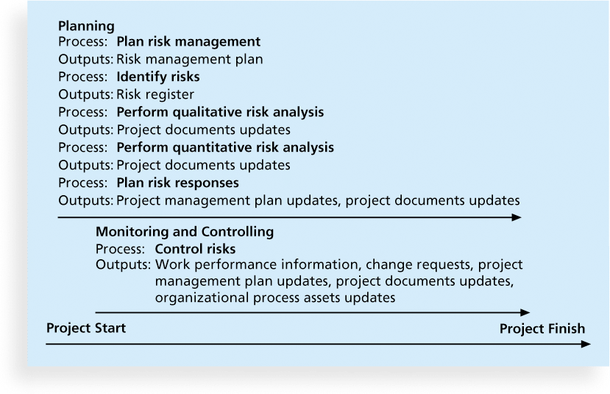
Figure 11-3. Project Risk Management Summary

Slide 10
Planning Risk Management
The main output of this process is a risk management plan—a plan that documents the procedures for managing risk throughout a project
The project team should review project documents and understand the organization’s and the sponsor’s approaches to risk
The level of detail will vary with the needs of the project
Notes:
Plan for the Planning
Risk planning should be appropriate for the project
Question you should ask:
How risky is the project?
Is it a new technology or something your organization is familiar with?
Do you have past projects to reference?
What is the visibility of the project?
How big is the project?
How important is the project?

Slide 11
Topics Addressed in a Risk Management Plan
Methodology
Roles and responsibilities
Budget and schedule
Risk categories
Risk probability and impact
Revised stakeholders’ tolerances
Tracking
Risk documentation
Notes:
What should it include?
How you will identify, quantify or qualify risk
Methods and tools
Budget…yes budget
Who is doing what
How often
Risk categories, levels, and thresholds for action.
Reporting requirements
Monitoring, tracking and documenting strategies
Budget – should include contingency funding for unknown risks, also should include the cost of the process itself (people’s time and efforts to identify, monitor and control)
WHO… - Every risk “above the line” should have a sponsor or watcher responsible for it.
WHEN… - Establishes the risk tolerance threshold for the project
Reports – Who, when, how often, what, etc.
Monitoring… - Again…WHO, HOW, HOW OFTEN, etc. It is iterative. Also, record keeping is essential to assist in future projects

Slide 12
Contingency and Fallback Plans, Contingency Reserves
Contingency plans are predefined actions that the project team will take if an identified risk event occurs
Fallback plans are developed for risks that have a high impact on meeting project objectives, and are put into effect if attempts to reduce the risk are not effective
Contingency reserves or allowances are provisions held by the project sponsor or organization to reduce the risk of cost or schedule overruns to an acceptable level; management reserves are funds held for unknown risks

Slide 13
Common Sources of Risk in Information Technology Projects
Several studies show that IT projects share some common sources of risk
The Standish Group developed an IT success potential scoring sheet based on potential risks
Other broad categories of risk help identify potential risks

Slide 14
Table 11-3. IT Success Potential Scoring Sheet

Slide 15
Broad Categories of Risk
Market risk
Financial risk
Technology risk
People risk
Structure/process risk
Notes:
Risk type Possible risks
Technology The database used in the system cannot process as many transactions per second as expected. Software components that should be reused contain defects that limit their functionality.
People It is impossible to recruit staff with the skills required. Key staff are ill and unavailable at critical times. Required training for staff is not available.
Organizational The organization is restructured so that different management are responsible for the project.
Organizational financial problems force reductions in the project budget.
Tools The code generated by CASE tools is inefficient.
CASE tools cannot be integrated.
Requirements Changes to requirements that require major design rework are proposed.
Customers fail to understand the impact of requirements changes.
Estimation The time required to develop the software is underestimated.
The rate of defect repair is underestimated.
The size of the software is underestimated.

Slide 16
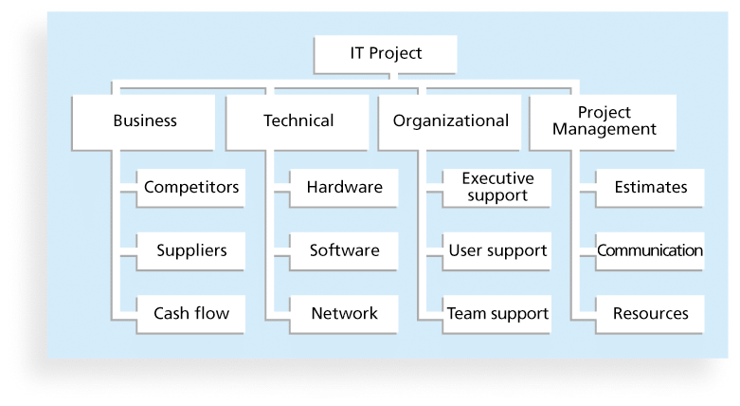
Risk Breakdown Structure
A risk breakdown structure is a hierarchy of potential risk categories for a project
Similar to a work breakdown structure but used to identify and categorize risks

Slide 17
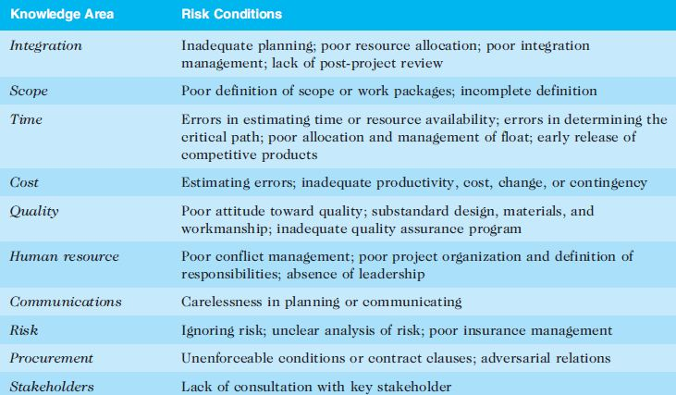
Potential Negative Risk Conditions Associated With Each Knowledge Area

Slide 18
Identifying Risks
Identifying risks is the process of understanding what potential events might hurt or enhance a particular project
Another consideration is the likelihood of advanced discovery
Risk identification tools and techniques include:
Brainstorming
The Delphi Technique
Interviewing
SWOT analysis
Checklist
Notes:
Continuous, Iterative Process
What – Can’t tell you…Different for each project and person consulted. In the end it is a long list.
Sooner – Needs to be done as soon as a project is identified, and in some cases before the project is even approved
More – The more heads you involve (stakeholders) the better the process outcome will be
Fact – That which is a known is by definition not an uncertainty. If you know something is going to occur then you plan for it not the risk of it.
Specific – You should be able to identify the risk and a trigger/cause of the risk. Example: The hardware may arrive late (TRIGGER) causing a delay in the schedule (RISK).
Should be able to answer – WHAT & WHY
Don’t… - Don’t try to qualify, quantify, or remedy at this point…that is coming.

Slide 19
Brainstorming
Brainstorming is a technique by which a group attempts to generate ideas or find a solution for a specific problem by amassing ideas spontaneously and without judgment
An experienced facilitator should run the brainstorming session
Be careful not to overuse or misuse brainstorming.
Psychology literature shows that individuals produce a greater number of ideas working alone than they do through brainstorming in small, face-to-face groups
Group effects often inhibit idea generation

Slide 20
Delphi Technique
The Delphi Technique is used to derive a consensus among a panel of experts who make predictions about future developments
Provides independent and anonymous input regarding future events
Uses repeated rounds of questioning and written responses and avoids the biasing effects possible in oral methods, such as brainstorming

Slide 21
Interviewing
Interviewing is a fact-finding technique for collecting information in face-to-face, phone, e-mail, or instant-messaging discussions
Interviewing people with similar project experience is an important tool for identifying potential risks

Slide 22
SWOT Analysis
SWOT analysis (strengths, weaknesses, opportunities, and threats) can also be used during risk identification
Helps identify the broad negative and positive risks that apply to a project

Slide 23
Risk Register
The main output of the risk identification process is a list of identified risks and other information needed to begin creating a risk register
A risk register is:
A document that contains the results of various risk management processes and that is often displayed in a table or spreadsheet format
A tool for documenting potential risk events and related information
Risk events refer to specific, uncertain events that may occur to the detriment or enhancement of the project

Slide 24
Risk Analysis
Assess the likelihood and impact of identified risks to determine their magnitude and priority
Assess probability, seriousness, and urgency of each risk.
Probability may be very low, low, moderate, high or very high.
Risk effects might be catastrophic, serious, tolerable or insignificant.
Urgency might be immediate, short term, or long term.
Notes:
Assess probability, seriousness, and urgency of each risk.
Probability may be very low, low, moderate, high or very high.
Risk effects might be catastrophic, serious, tolerable or insignificant.
Urgency might be immediate, short term, or long term.

Slide 25
Analyzing Risk
Qualitative Risk Analysis
Quantitative Risk Analysis
Subjective
Educated Guess
High, Medium, Low
Red, Yellow, Green
1-10
Prioritized/Ranked list of ALL identified risks
First step in risk analysis!
Numerical/Statistical Analysis
Determines probability of occurrence and consequences of risks
Should be focused to highest risks as determined by Qualitative Risk Analysis and Risk Threshold

Slide 26
Planning Risk Responses
After identifying and quantifying risks, you must decide how to respond to them
Four main response strategies for negative risks:
Risk avoidance
Risk acceptance
Risk transference
Risk mitigation
Notes:
“What are we going to do about it?”
Techniques/Strategies:
Avoidance – Eliminate it
Transference – Pawn it off
Mitigation – Reduce probability or impact of it
Acceptance – Do nothing
Strategy should be commensurate with risk
Hint: Don’t spend more money preventing the risk than the impact of the risk would be if it occurs ☺
The Risk Response Plan/Risk Response Register
Risk avoidance is the elimination of hazards, activities and exposures that can negatively affect an organization's assets. Whereas risk management aims to control the damages and financial consequences of threatening events,. i.e – can we change the plan to avoid the risk.
Accepting risk occurs when the cost of managing a certain type of risk is accepted, because the risk involved is not adequate enough to warrant the added cost it will take to avoid that risk.
risk avoidance seeks to avoid compromising events entirely.
Risk Transference refers to the shifting of the burden of loss for a risk to another party through legislation, contract, insurance or other means. Transfer the risk or responsibility of the risk to a third party. Insurance, performance bonds, warranties, guarantees.
Risk mitigation is defined as taking steps to reduce adverse effects. There are four types of risk mitigation strategies that hold unique to Business Continuity and Disaster Recovery. It's important to develop a strategy that closely relates to and matches your company's profile. Usually involves increased costs/budget, but overall the goal is to try and lessen the risk to an acceptable level.
Examples:
Conducting more tests (reduces the problem)
Choosing a more established vendor (reduces the problem)
Adding resources or time to project (reduces impact)
Designing redundancy into a system (reduces impact)

Slide 27
Response Strategies for Positive Risks
Risk exploitation
Risk sharing
Risk enhancement
Risk acceptance

Slide 28
Residual and Secondary Risks
It’s also important to identify residual and secondary risks
Residual risks are risks that remain after all of the response strategies have been implemented
Secondary risks are a direct result of implementing a risk response

Slide 29
Monitoring and Controlling Risks
Involves executing the risk management process to respond to risk events and ensuring that risk awareness is an ongoing activity performed by the entire project team throughout the entire project
Workarounds are unplanned responses to risk events that must be done when there are no contingency plans
Main outputs of risk control are:
Work performance information
change requests
updates to the project management plan, other project documents, and organizational process assets
Notes:
Assess each identified risk regularly to decide whether or not it is becoming less or more probable.
Also assess whether the effects of the risk have changed.
Each key risk should be discussed at management progress meetings.
Continuous, Iterative Process
Done right the risk impact will be minimized:
Someone IS responsible
Watch for risk triggers
Communicate…Communicate…Communicate
Take corrective action - Execute
Re-evaluate and look for new risk constantly
Tools:
Risk Reviews
Risk Audits

Slide 30
Results of Good Project Risk Management
Unlike crisis management, good project risk management often goes unnoticed
Well-run projects appear to be almost effortless, but a lot of work goes into running a project well
Project managers should strive to make their jobs look easy to reflect the results of well-run projects

Slide 31
Chapter Summary
Project risk management is the art and science of identifying, analyzing, and responding to risk throughout the life of a project and in the best interests of meeting project objectives
Main processes include:
Plan risk management
Identify risks
Perform qualitative risk analysis
Perform quantitative risk analysis
Plan risk responses
Control risks

